Slide 1
HOSTS:
Adrian Schermer | Robert Delavan
Lance Johnson
Episode 1 of 3

Slide 2
online
Episode 1 of 3

Slide 3
SPECIAL GUEST
Mathew Stockstill
Mathew Stockstill Architect, LLC
Episode 1 of 3

Slide 4
Today we will be speaking with Mathew Stockstill
with Mathew Stockstill Architect, LLC.
Mathew is an architect specializing in guiding and collaborative processes with
clients on residential, and small to mid-size public and commercial projects.
Mathew’s firm offers design, project consultation, permit assistance,
drafting, and construction administration services in both Oregon, and Missouri.
Adrian Schermer | Robert Delavan
Lance Johnson
Episode 1 of 3

Slide 5
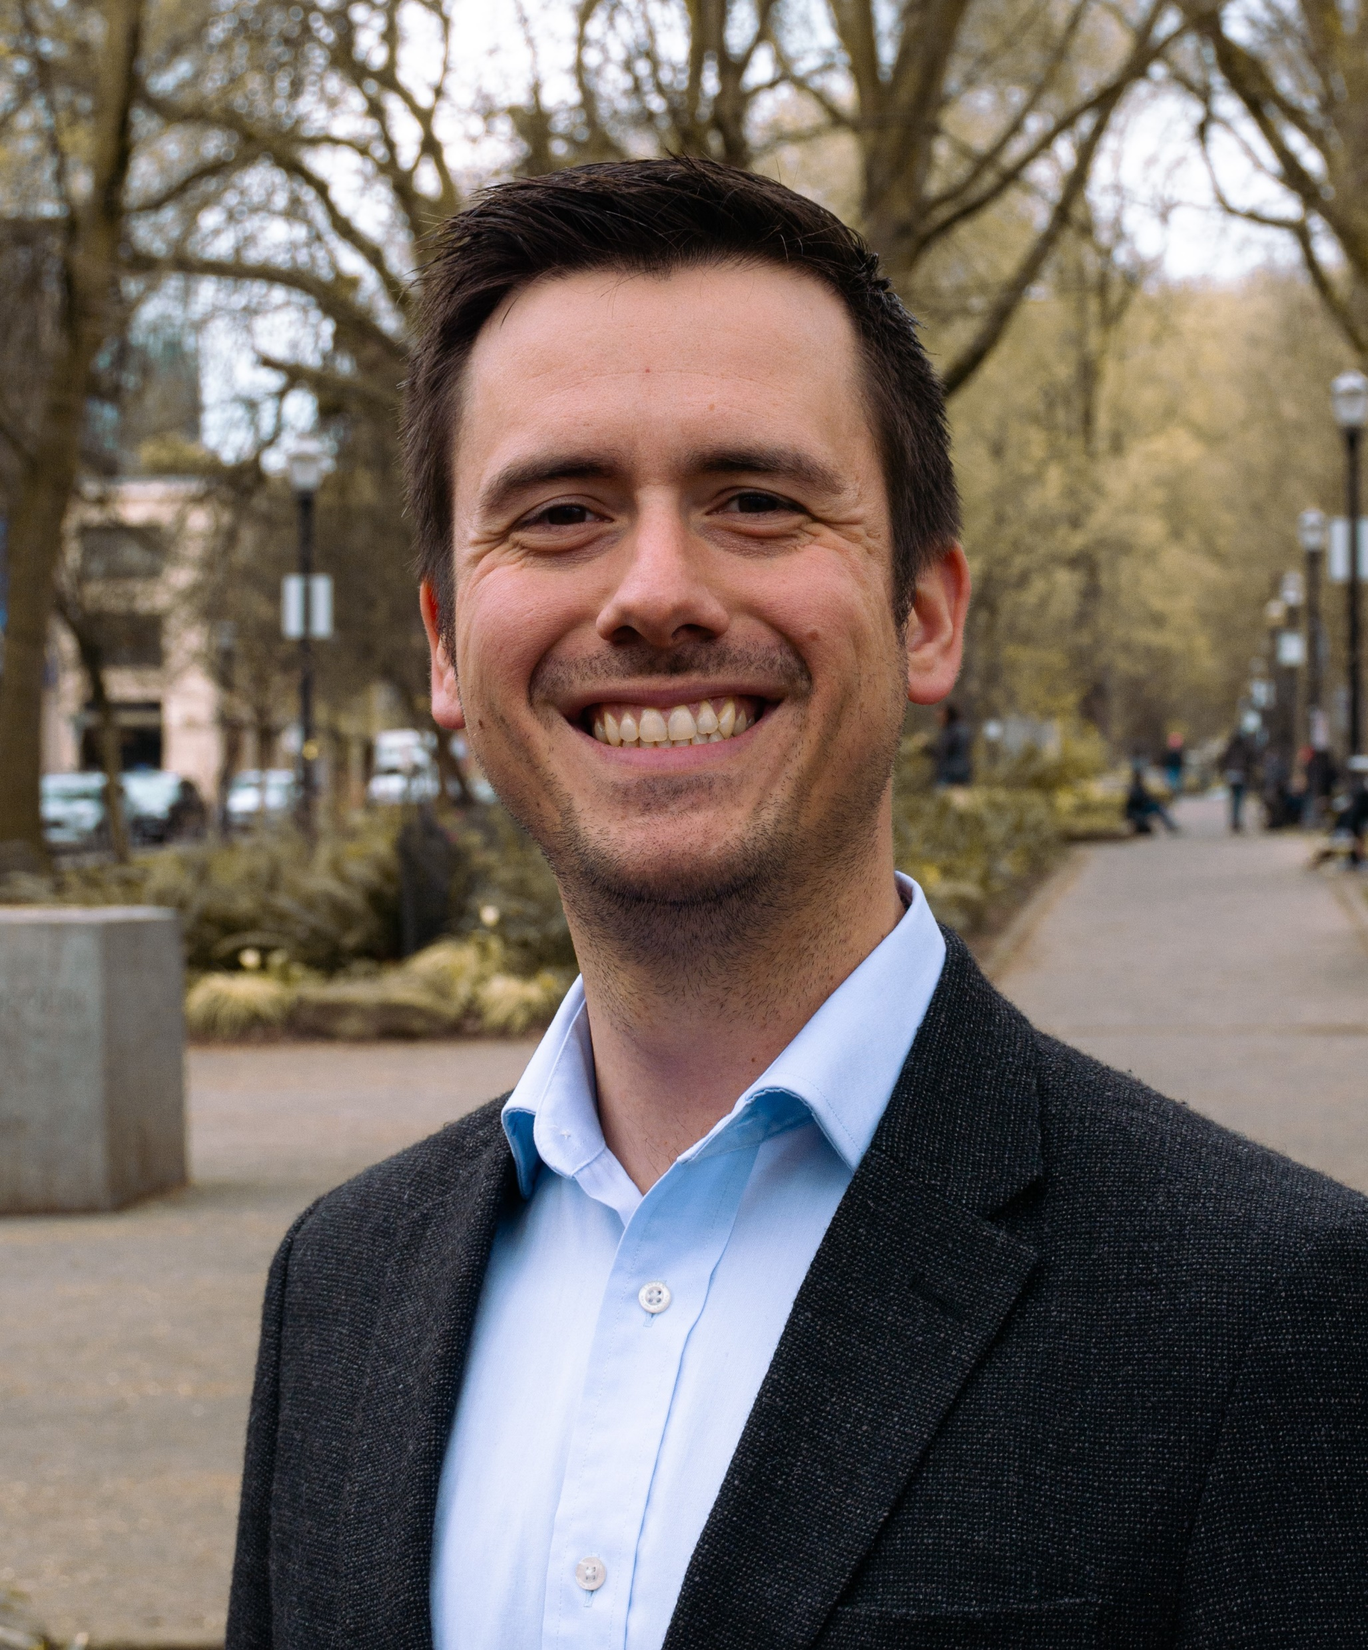
PODCAST RECAP
Today we will be getting to
know Mathew, and learning about what
made him into the person he is today.
Episode 1 of 3

Slide 6
QUESTION ONE
Tell us your story!
Where’d you grow up? What was your family like?
Episode 1 of 3

Slide 7
QUESTION TWO
What is a significant story that made an impact on your life, and what life lessons have you learned to make you into the person you are today?
Episode 1 of 3

Slide 8
QUESTION THREE
What advice would you give
to your younger self?
Episode 1 of 3

Slide 9
Mathew Stockstill
Mathew Stockstill Architect LLC
Email: mstockstill@mstockstillarchitect.com
Phone: 660-221-2517
Episode 1 of 3

Slide 10
971-276-0158
Mathew Stockstill Architect, LLC
www.mstockstillarchitect.com
503-941-5925
503-970-8741
Episode 1 of 3

Slide 11
roi-fa.com/events
Summer Bash – August 20th
Photos with Santa – November 12th
Episode 1 of 3

Slide 12
