Slide 1
HOSTS:
Adrian Schermer | Robert Delavan
Lance Johnson
Episode 2 of 3

Slide 2
online
Episode 2 of 3

Slide 3
SPECIAL GUEST
Mathew Stockstill
Mathew Stockstill Architect, LLC
Episode 2 of 3

Slide 4
Today we will be speaking with Mathew Stockstill
with Mathew Stockstill Architect, LLC.
Mathew is an architect specializing in guiding and engaging in collaborative processes with clients on residential, and small to mid-size public and commercial projects. Mathew’s firm offers design, project consultation, permit assistance, drafting, and construction administration services in both Oregon, and Missouri.
Adrian Schermer | Robert Delavan
Lance Johnson
Episode 2 of 3

Slide 5
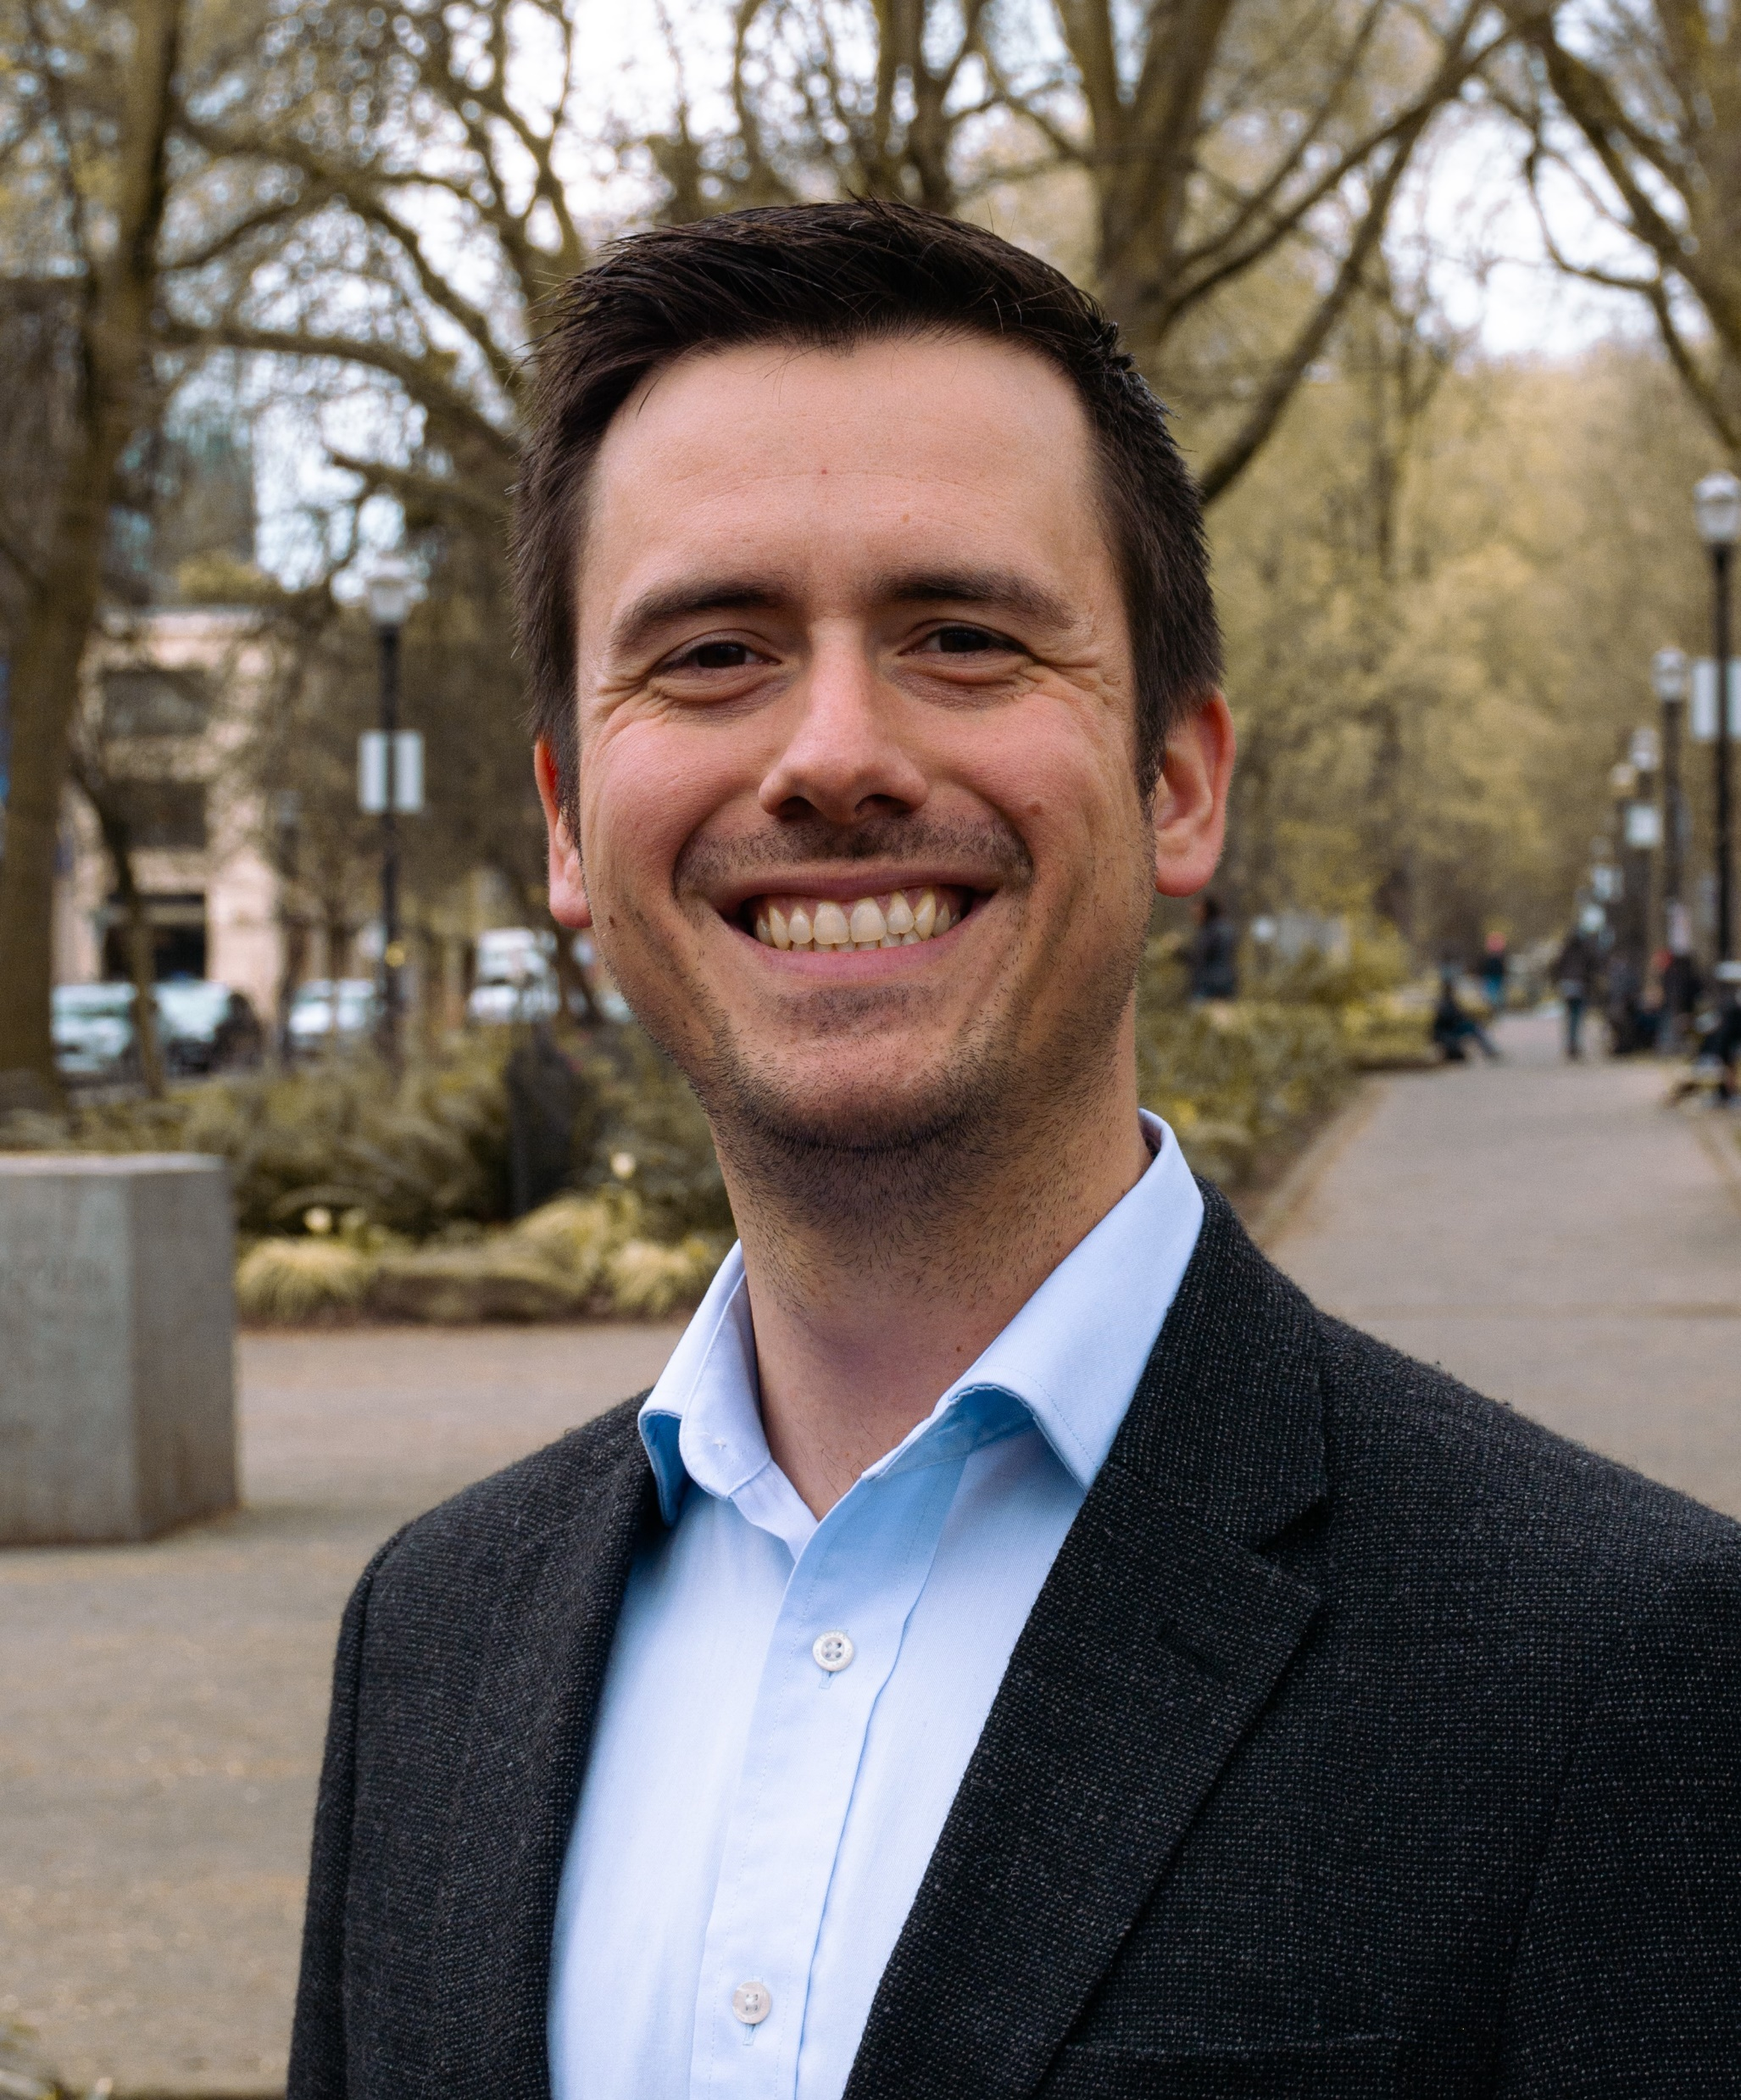
PODCAST RECAP
Today we will be getting to
know Mathew, and what sets him
apart at Mathew Stockstill Architect, LLC.
Episode 2 of 3

Slide 6
QUESTION ONE
Tell us about your business and what
makes you so passionate about it!
What makes you different and sets you apart?
Episode 2 of 3

Slide 7
QUESTION TWO
What do you get asked most by your clients, and what’s the number one pain
point that you solve?
Episode 2 of 3

Slide 8
QUESTION THREE
What are you most excited about right now?
Episode 2 of 3

Slide 9
Mathew Stockstill
Mathew Stockstill Architect LLC
Email: mstockstill@mstockstillarchitect.com
Phone: 660-221-2517
Episode 2 of 3

Slide 10
971-276-0158
Mathew Stockstill Architect, LLC
www.mstockstillarchitect.com
503-941-5925
503-970-8741
Episode 2 of 3

Slide 11
roi-fa.com/events
Summer Bash – August 20th
Photos with Santa – November 12th
Episode 2 of 3

Slide 12
