Slide 1
HOSTS:
Adrian Schermer | Robert Delavan
Lance Johnson
Episode 3 of 3

Slide 2
online
Episode 3 of 3

Slide 3
SPECIAL GUEST
Mathew Stockstill
Mathew Stockstill Architect, LLC
Episode 3 of 3

Slide 4
Today we will be speaking with Mathew Stockstill
with Mathew Stockstill Architecture, LLC.
Mathew is an architect specializing in guiding and collaborative processes with
clients on residential, and small to mid-size public and commercial projects.
Mathew’s firm offers design, project consultation, permit assistance,
drafting, and construction administration services in both Oregon, and Missouri.
Adrian Schermer | Robert Delavan
Lance Johnson
Episode 3 of 3

Slide 5
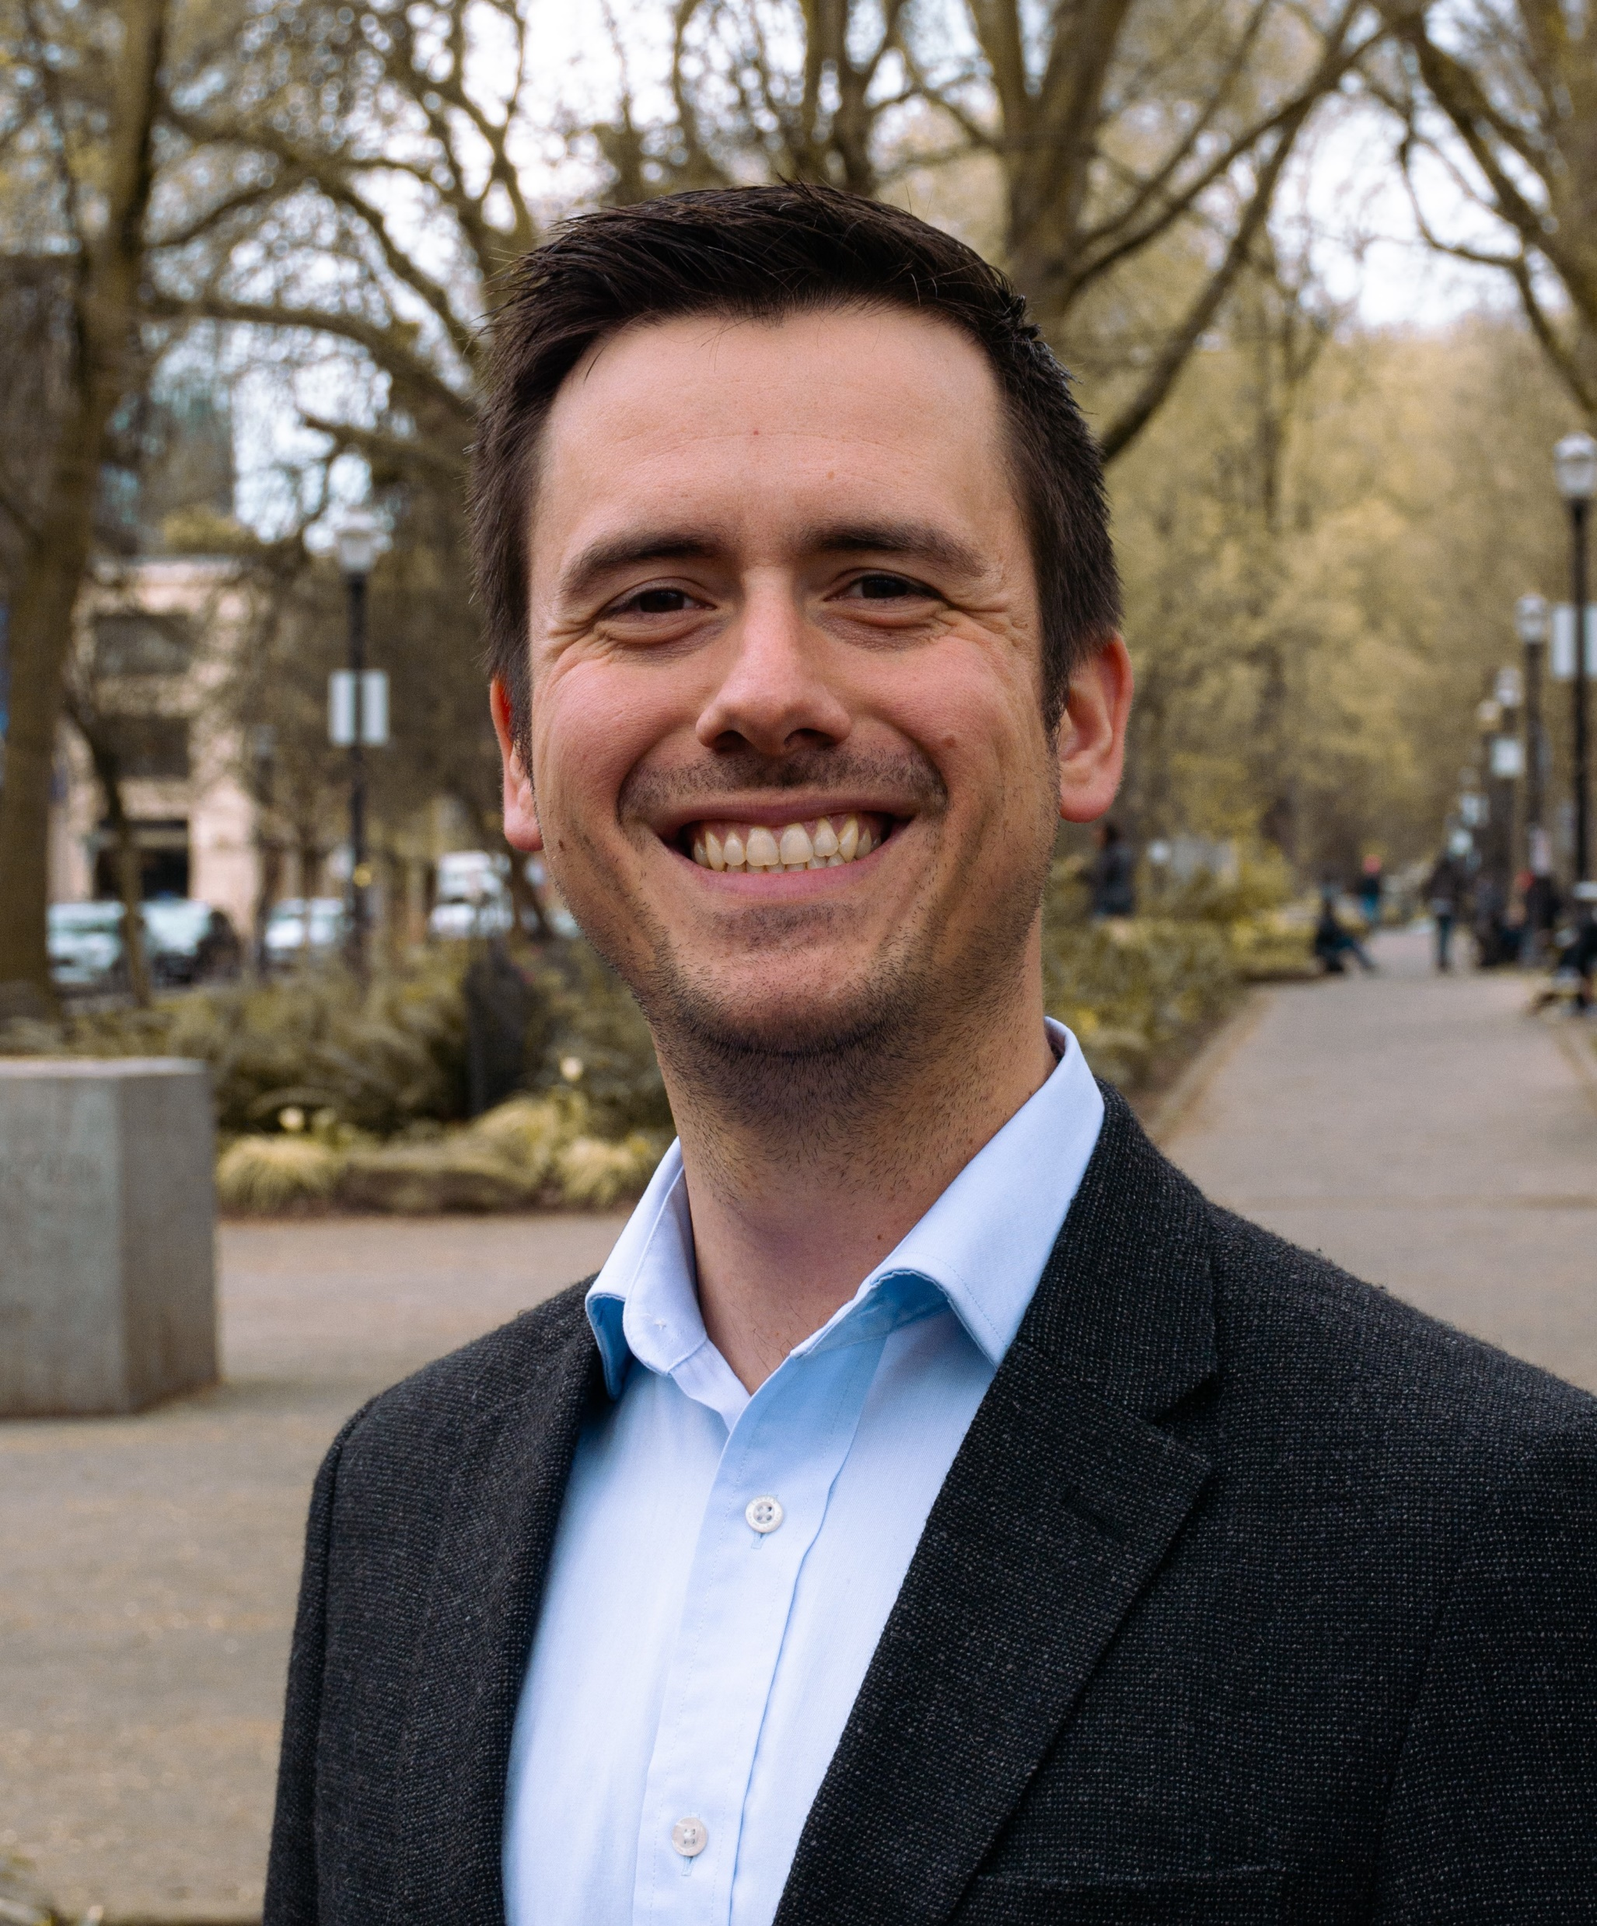
PODCAST RECAP
Today we will learning about Mathew,
and what what’s ahead at
Mathew Stockstill Architect, LLC.
Episode 3 of 3

Slide 6
QUESTION ONE
What are your 3 biggest goals right now?
Episode 3 of 3

Slide 7
QUESTION TWO
Who should we be on the look out to connect you with?
Episode 3 of 3

Slide 8
QUESTION THREE
Where do you see yourself in the next 5 years?
Episode 3 of 3

Slide 9
Mathew Stockstill
Mathew Stockstill Architect LLC
Email: mstockstill@mstockstillarchitect.com
Phone: 660-221-2517
Episode 3 of 3

Slide 10
971-276-0158
Mathew Stockstill Architect, LLC
www.mstockstillarchitect.com
503-941-5925
503-970-8741
Episode 3 of 3

Slide 11
roi-fa.com/events
Photos with Santa – November 12th
Episode 3 of 3

Slide 12
