Slide 1
HOSTS:
Adrian Schermer | Robert Delavan
Lance Johnson
Episode 2 of 3

Slide 2
online
Episode 2 of 3

Slide 3
SPECIAL GUEST
Barry Mack
Barry Mack Art
Episode 2 of 3

Slide 4
Today we will be speaking with Barry Mack
with Barry Mack Art.
Barry is a dynamic artist who creates
art specific to your needs.
Adrian Schermer | Robert Delavan
Lance Johnson
Episode 2 of 3

Slide 5
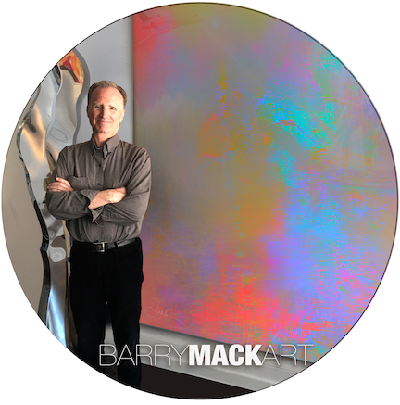
PODCAST RECAP
Today we will be learning
more about Barry, and what
he’s currently working on.
Episode 2 of 3

Slide 6
QUESTION ONE
What are you inspired by most?
Episode 2 of 3

Slide 7
QUESTION TWO
Why are The Arts relevant in today’s
polarized & uncertain world?
Episode 2 of 3

Slide 8
QUESTION THREE
Why are you doing a podcast?
Episode 2 of 3

Slide 9
Barry Mack
Barry Mack Art
Email: barrymackart@gmail.com
Phone: 971-348-1890
@BarryMackArt
Episode 2 of 3

Slide 10
971-276-0158
Barry Mack Art
www.barrymackart.com
503-941-5925
503-970-8741
Episode 2 of 3

Slide 11
roi-fa.com/events
Learn & Grow – August 12th
Summer Bash – August 20th
Photos with Santa – November 12th
Episode 2 of 3

Slide 12
