Slide 1
HOSTS:
Adrian Schermer | Robert Delavan
Lance Johnson
Episode 3 of 3

Slide 2
online
Episode 3 of 3

Slide 3
SPECIAL GUEST
Barry Mack
Barry Mack Art
Episode 3 of 3

Slide 4
Today we will be speaking with Barry Mack
with Barry Mack Art.
If you haven’t had a chance to listen to episode one and two
of this 3 part series I’d highly encourage you to!
It’s been a blast getting to know Barry.
Adrian Schermer | Robert Delavan
Lance Johnson
Episode 3 of 3

Slide 5
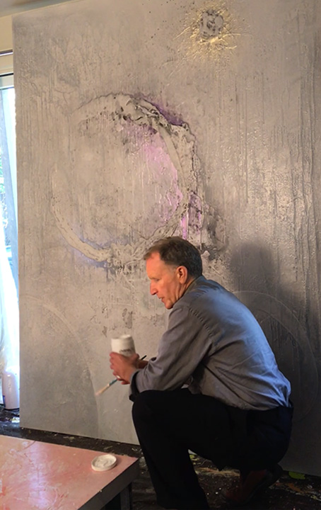
PODCAST RECAP
Today we are looking ahead
at what’s to come with Barry,
and Barry Mack Art.
Episode 3 of 3

Slide 6
QUESTION ONE
When you think about our future,
what gets you the most excited?
Episode 3 of 3

Slide 7
QUESTION TWO
What would you do if you knew
you would not fail?
Episode 3 of 3

Slide 8
QUESTION THREE
How are The Arts helping create
a better world for everyone?
Episode 3 of 3

Slide 9
Barry Mack
Barry Mack Art
Email: barrymackart@gmail.com
Phone: 971-348-1890
@BarryMackArt
Episode 3 of 3

Slide 10
971-276-0158
Barry Mack Art
www.barrymackart.com
503-941-5925
503-970-8741
Episode 3 of 3

Slide 11
roi-fa.com/events
Learn & Grow – August 12th
Summer Bash – August 20th
Photos with Santa – November 12th
Episode 3 of 3

Slide 12
