Slide 1
HOSTS:
Adrian Schermer | Robert Delavan
Lance Johnson
Episode 1 of 3

Slide 2
online
Episode 1 of 3

Slide 3
SPECIAL GUEST
Cathy Winslow
Globe Life - Family Heritage Division
Episode 1 of 3

Slide 4
Today we will be speaking with Cathy Winslow
with Globe Life - Family Heritage Division.
Cathy helps protect individuals and families
financially when their lives are turned upside
down by a cancer diagnosis, accidental injury,
heart attack/stroke, or an ICU stay.
Adrian Schermer | Robert Delavan
Lance Johnson
Episode 1 of 3

Slide 5
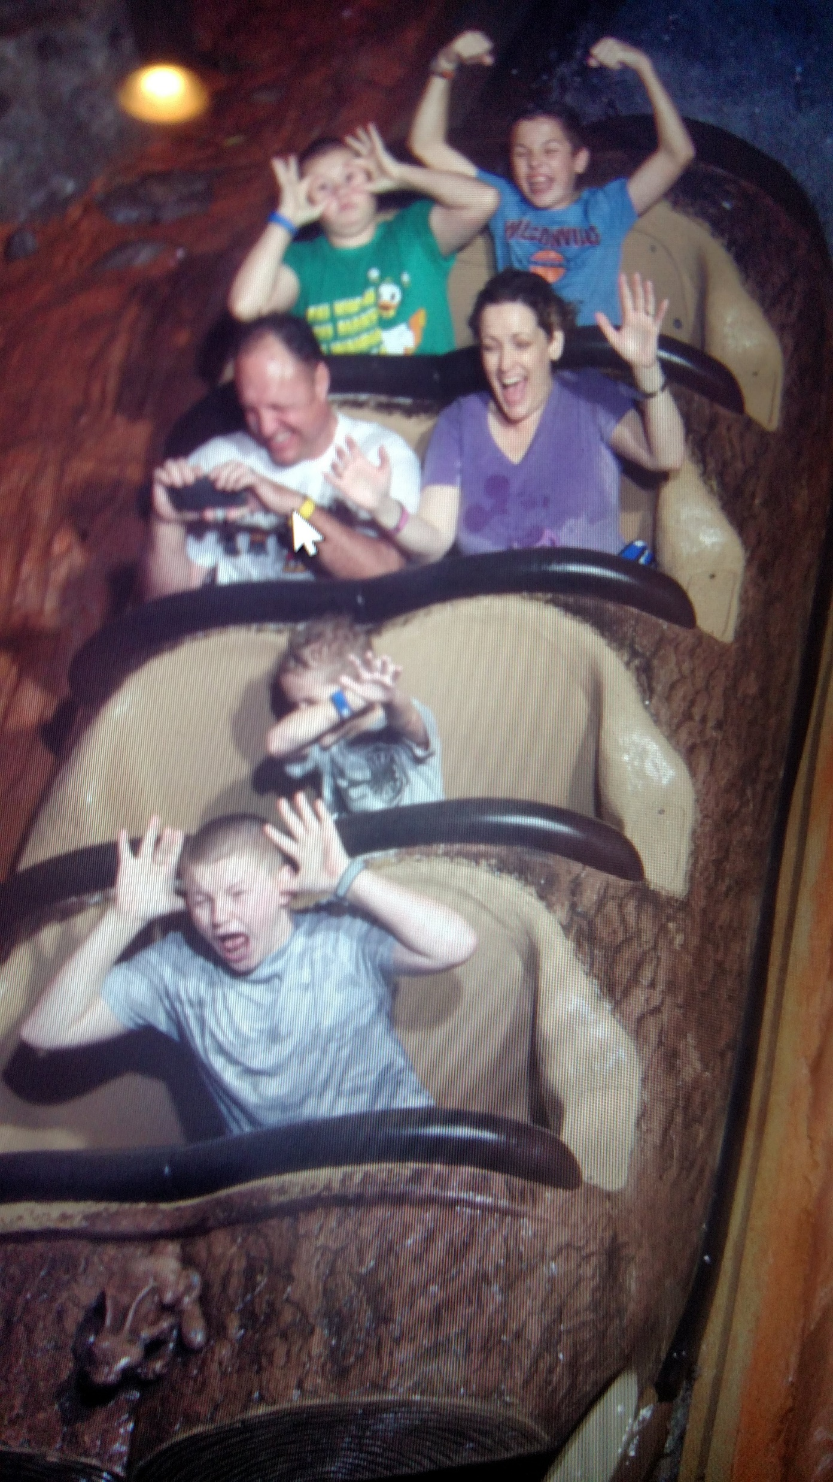
PODCAST RECAP
Today we will be getting to
know Cathy, and learning about what
made her into the person she is today.
Episode 1 of 3

Slide 6
Book Recommendation!
Episode 1 of 3

Slide 7
QUESTION ONE
Where did you grow up?
Episode 1 of 3

Slide 8
QUESTION TWO
What was your childhood like?
Episode 1 of 3

Slide 9
QUESTION THREE
What is a significant story that
made an impact on your life?
Episode 1 of 3

Slide 10
Cathy Winslow
Globe Life – Family Heritage Division
Email: Cwins2020@gmail.com
Phone: 503-862-6980
@globelifefhd
Cathy Winslow Agent
Episode 1 of 3

Slide 11
971-276-0158
Globe Life – Family Heritage Division
CathyWinslow.com
503-941-5925
503-970-8741
Episode 1 of 3

Slide 12
roi-fa.com/events
Learn & Grow – August 12th
Summer Bash – August 20th
Photos with Santa – November 12th
Episode 1 of 3

Slide 13
