Slide 1
HOSTS:
Adrian Schermer | Robert Delavan
Lance Johnson
Episode 2 of 3

Slide 2
online
Episode 2 of 3

Slide 3
SPECIAL GUEST
Cathy Winslow
Globe Life - Family Heritage Division
Episode 2 of 3

Slide 4
Today we will be speaking again with Cathy Winslow
with Globe Life - Family Heritage Division
and learning more about the positive
impact she’s making in the community.
Adrian Schermer | Robert Delavan
Lance Johnson
Episode 2 of 3

Slide 5
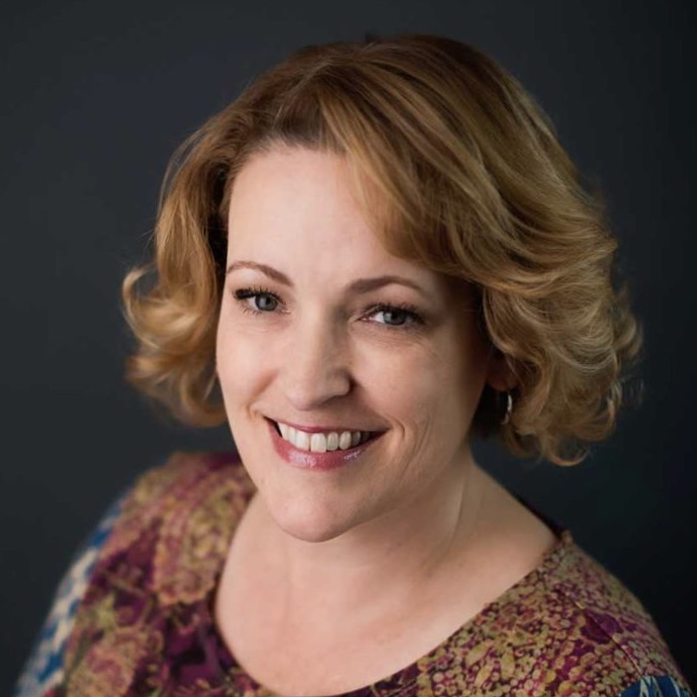
PODCAST RECAP
We are excited to have
Cathy back on the show!
This is episode 2 of a 3-part series!
Episode 2 of 3

Slide 6
Book Recommendation!
Episode 2 of 3

Slide 7
QUESTION ONE
Tell us about your business and what
makes you so passionate about it.
Episode 2 of 3

Slide 8
QUESTION TWO
What sets you apart from your competition?
Episode 2 of 3

Slide 9
QUESTION THREE
What energizes you and keeps you going?
Episode 2 of 3

Slide 10
Cathy Winslow
Globe Life – Family Heritage Division
Email: Cwins2020@gmail.com
Phone: 503-862-6980
@globelifefhd
Cathy Winslow Agent
Episode 2 of 3

Slide 11
971-276-0158
Globe Life – Family Heritage Division
CathyWinslow.com
503-941-5925
503-970-8741
Episode 2 of 3

Slide 12
roi-fa.com/events
Learn & Grow – August 12th
Summer Bash – August 20th
Photos with Santa – November 12th
Episode 2 of 3

Slide 13
