Slide 1
HOSTS:
Adrian Schermer | Robert Delavan
Lance Johnson
Episode 3 of 3

Slide 2
online
Episode 3 of 3

Slide 3
SPECIAL GUEST
Cathy Winslow
Globe Life - Family Heritage Division
Episode 3 of 3

Slide 4
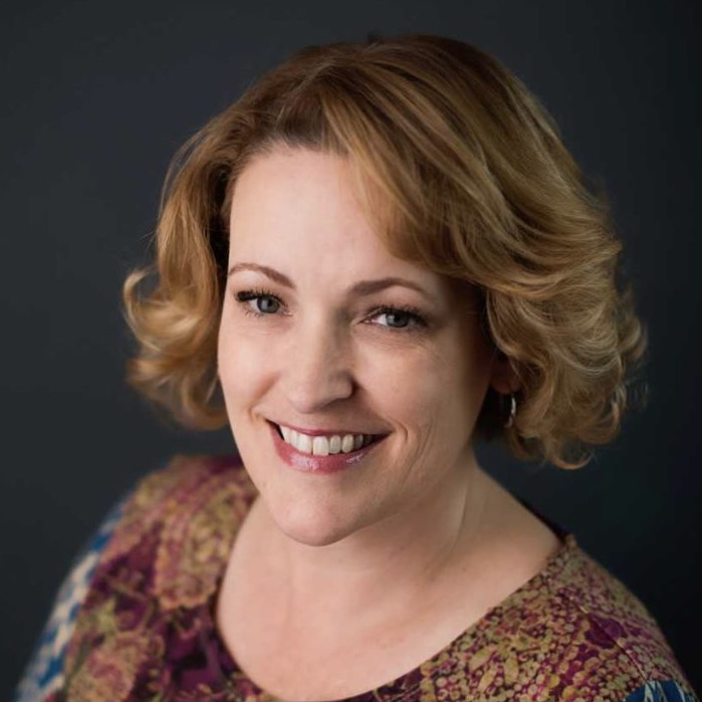
PODCAST RECAP
Today is our final episode with
Cathy in this 3 – part series.
Today we will be learning all about
what’s ahead for her and her future with
Globe Life-Family Heritage Division!
Episode 3 of 3

Slide 5
Book Recommendation!
Episode 3 of 3

Slide 6
QUESTION ONE
Who should we be on the lookout
for to connect you with?
Episode 3 of 3

Slide 7
QUESTION TWO
What are your plans for growth?
Episode 3 of 3

Slide 8
QUESTION THREE
What are the benefits in your
line of work for longevity?
Episode 3 of 3

Slide 9
Cathy Winslow
Globe Life – Family Heritage Division
Email: Cwins2020@gmail.com
Phone: 503-862-6980
@globelifefhd
Cathy Winslow Agent
Episode 3 of 3

Slide 10
971-276-0158
Globe Life – Family Heritage Division
CathyWinslow.com
503-941-5925
503-970-8741
Episode 3 of 3

Slide 11
roi-fa.com/events
Learn & Grow – August 12th
Summer Bash – August 20th
Photos with Santa – November 12th
Episode 3 of 3

Slide 12
